Slide 1

CM20315 - Machine Learning
Prof. Simon Prince
5. Loss functions

Slide 2
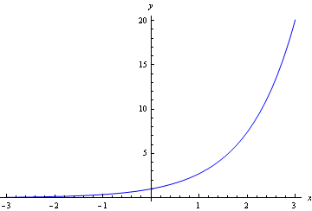
Log and exp functions
Log
Exp
Two rules:

Slide 3
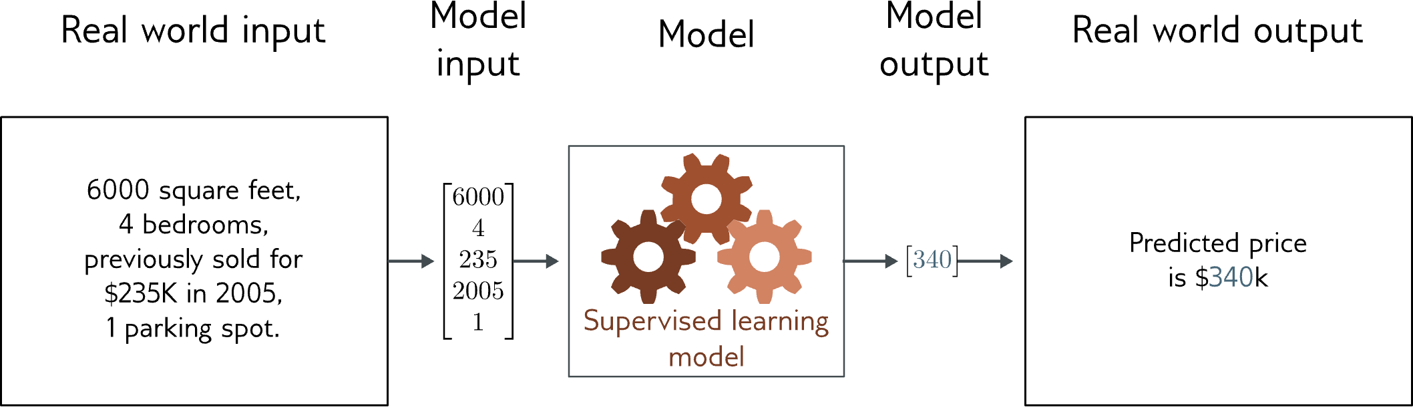
Regression
Univariate regression problem (one output, real value)

Slide 4
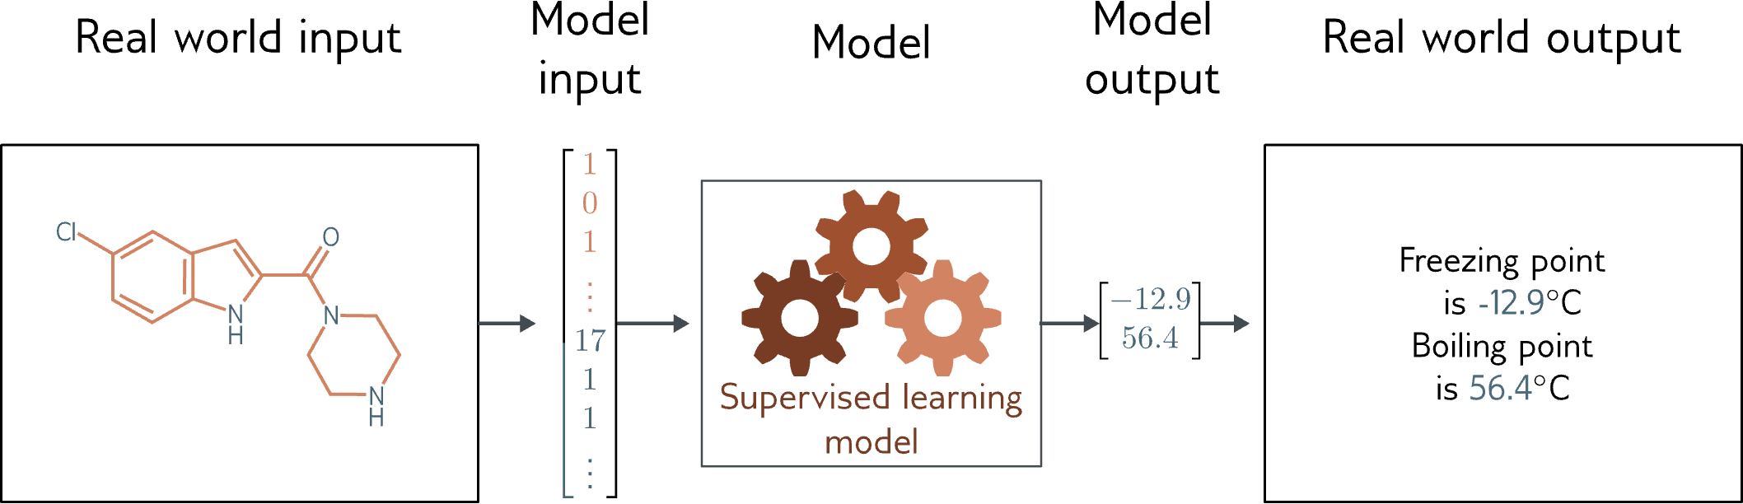
Graph regression
Multivariate regression problem (>1 output, real value)

Slide 5
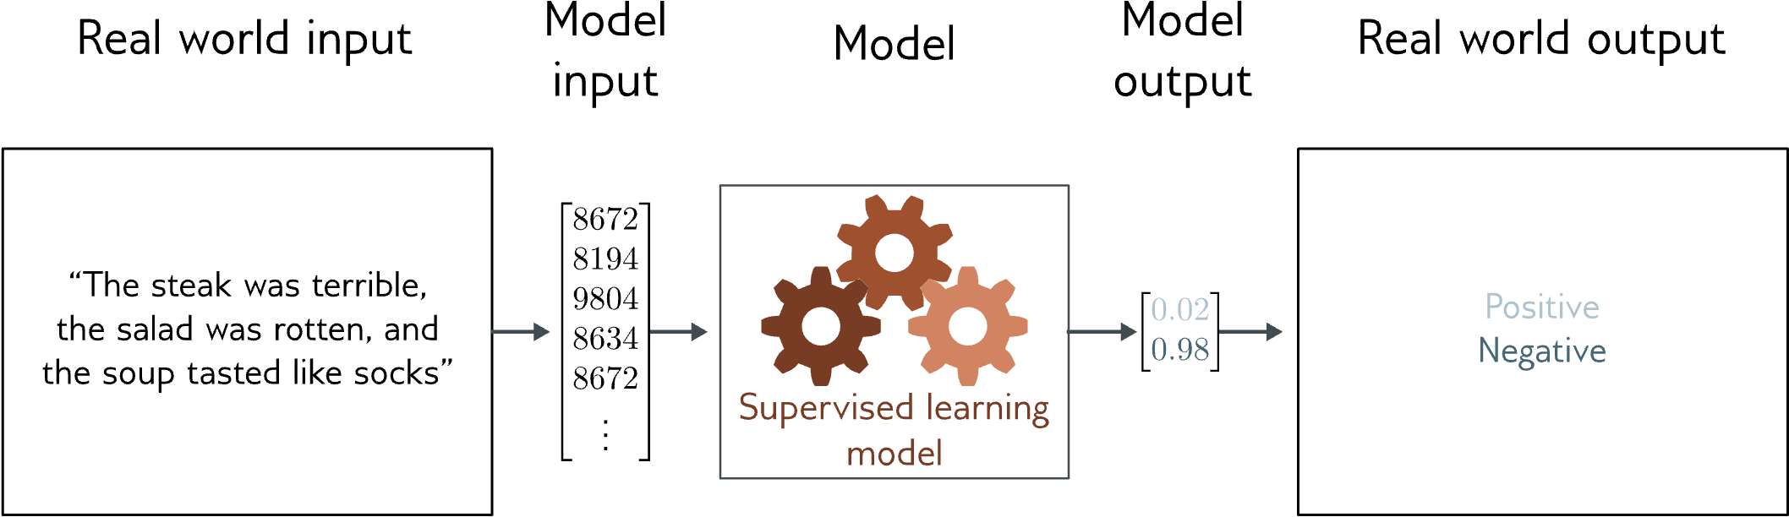
Text classification
Binary classification problem (two discrete classes)

Slide 6
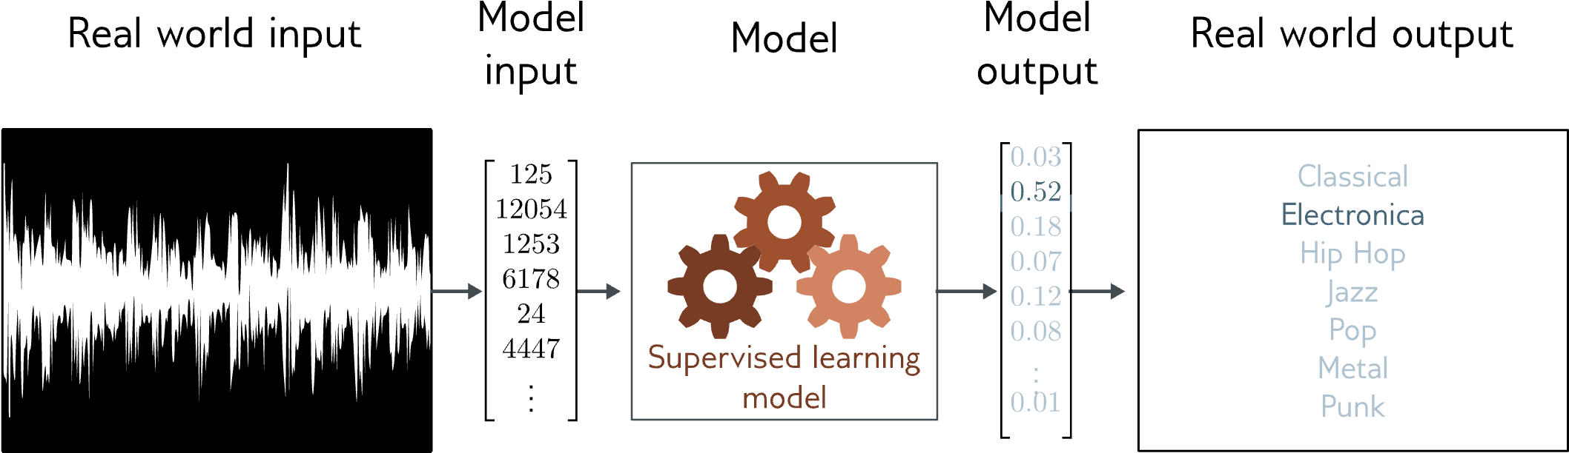
Music genre classification
Multiclass classification problem (discrete classes, >2 possible values)

Slide 10
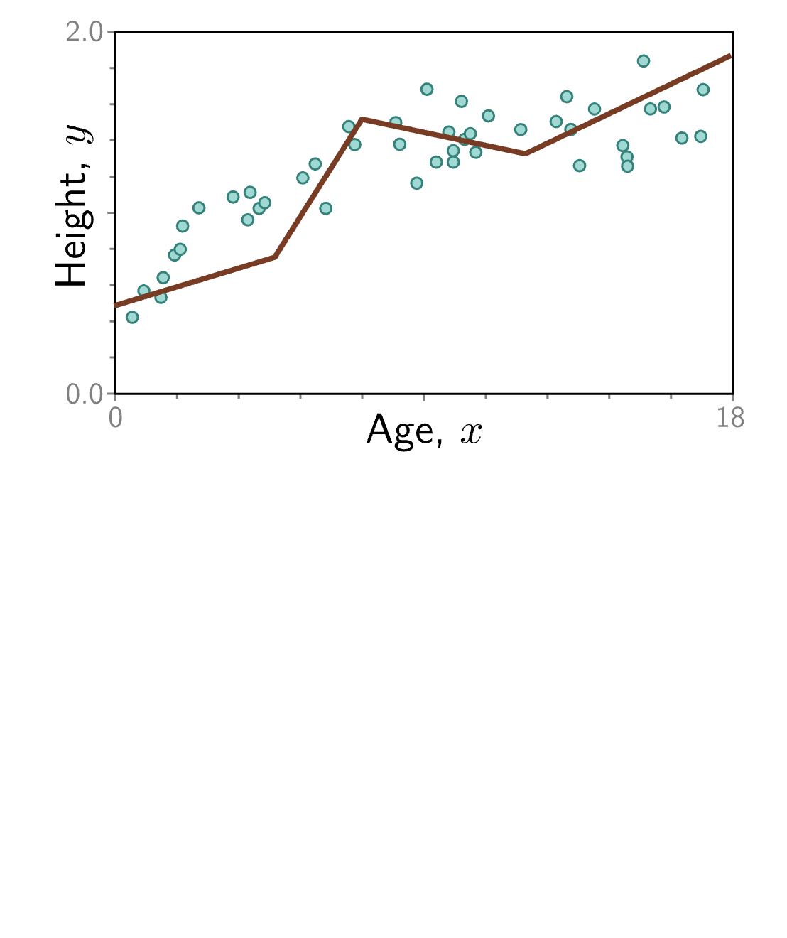

Slide 27
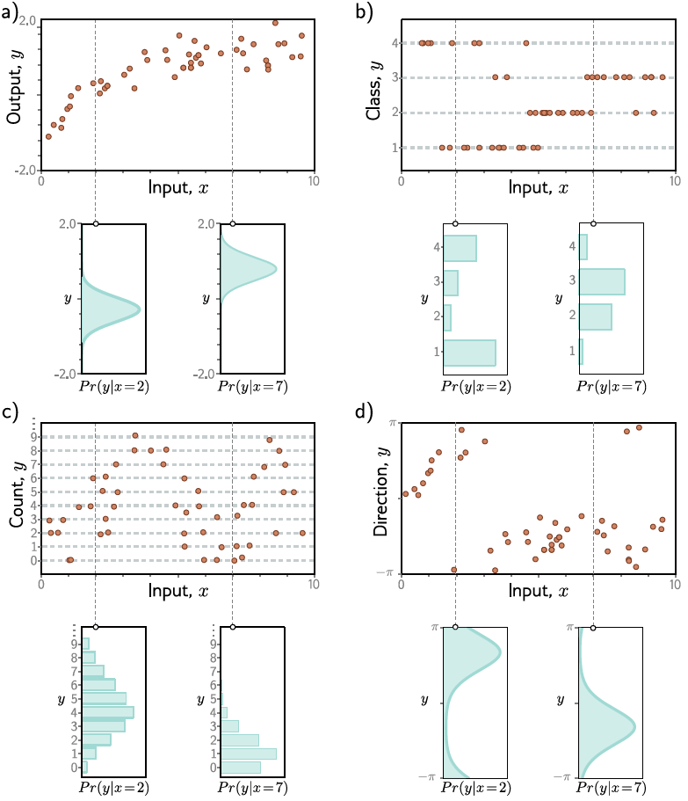

Slide 31
Loss function
Training dataset of I pairs of input/output examples:
Loss function or cost function measures how bad model is:
or for short:

Slide 32
Loss function
Training dataset of I pairs of input/output examples:
Loss function or cost function measures how bad model is:
or for short:
Returns a scalar that is smaller when model maps inputs to outputs better

Slide 33
Training
Loss function:
Find the parameters that minimize the loss:
Returns a scalar that is smaller when model maps inputs to outputs better

Slide 34
Example: 1D Linear regression loss function
Loss function:
“Least squares loss function”

Slide 35
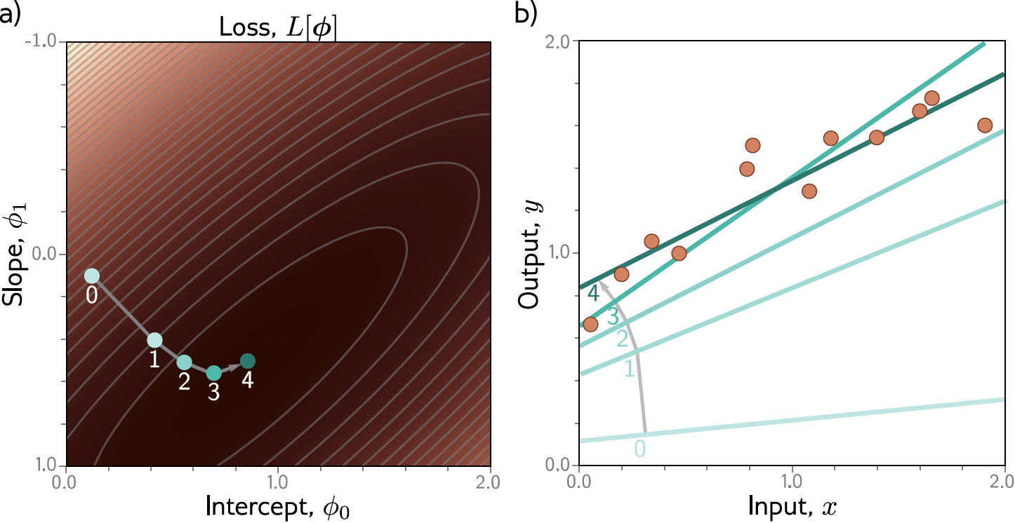
Example: 1D Linear regression training
This technique is known as gradient descent

Slide 36
Loss functions
Maximum likelihood
Recipe for loss functions
Example 1: univariate regression
Example 2: binary classification
Example 3: multiclass classification
Other types of data
Multiple outputs
Cross entropy

Slide 37
How to construct loss functions
Model predicts output y given input x

Slide 38
How to construct loss functions
Model predicts output y given input x

Slide 39
How to construct loss functions
Model predicts output y given input x
Model predicts a conditional probability distribution:
over outputs y given inputs x.
Loss function aims to make the outputs have high probability

Slide 40
How can a model predict a probability distribution?
Pick a known distribution (e.g., normal distribution) to model output y with parameters
e.g., the normal distribution
2. Use model to predict parameters of probability distribution

Slide 41
Maximum likelihood criterion
When we consider this probability as a function of the parameters , we call it a likelihood.

Slide 42
Problem:
The terms in this product might all be small
The product might get so small that we can’t easily represent it

Slide 43
The log function is monotonic
Maximum of the logarithm of a function is in the same place as maximum of function

Slide 44
Maximum log likelihood
Now it’s a sum of terms, so doesn’t matter so much if the terms are small

Slide 45
Minimizing negative log likelihood
By convention, we minimize things (i.e., a loss)

Slide 46
Inference
But now we predict a probability distribution
We need an actual prediction (point estimate)
Find the peak of the probability distribution (i.e., mean for normal)

Slide 47
Loss functions
Maximum likelihood
Recipe for loss functions
Example 1: univariate regression
Example 2: binary classification
Example 3: multiclass classification
Other types of data
Multiple outputs
Cross entropy

Slide 48
Recipe for loss functions

Slide 49
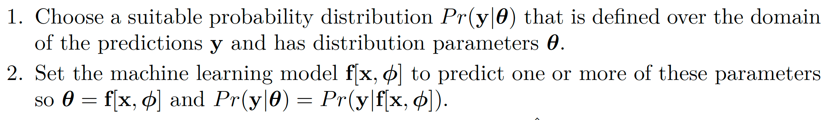
Recipe for loss functions

Slide 50
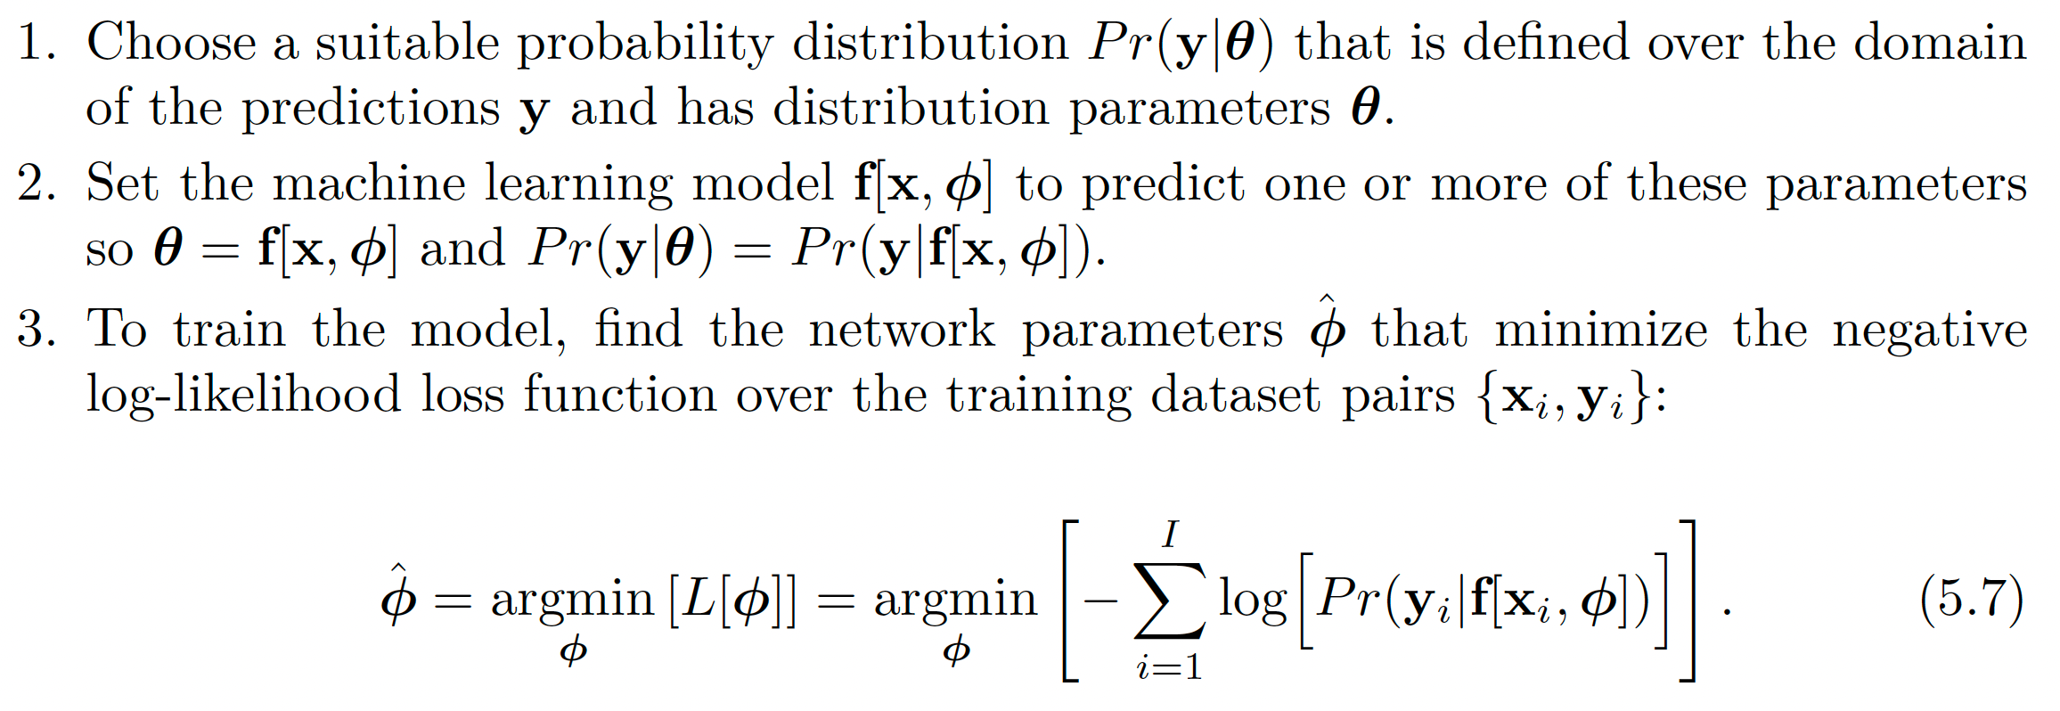
Recipe for loss functions

Slide 51
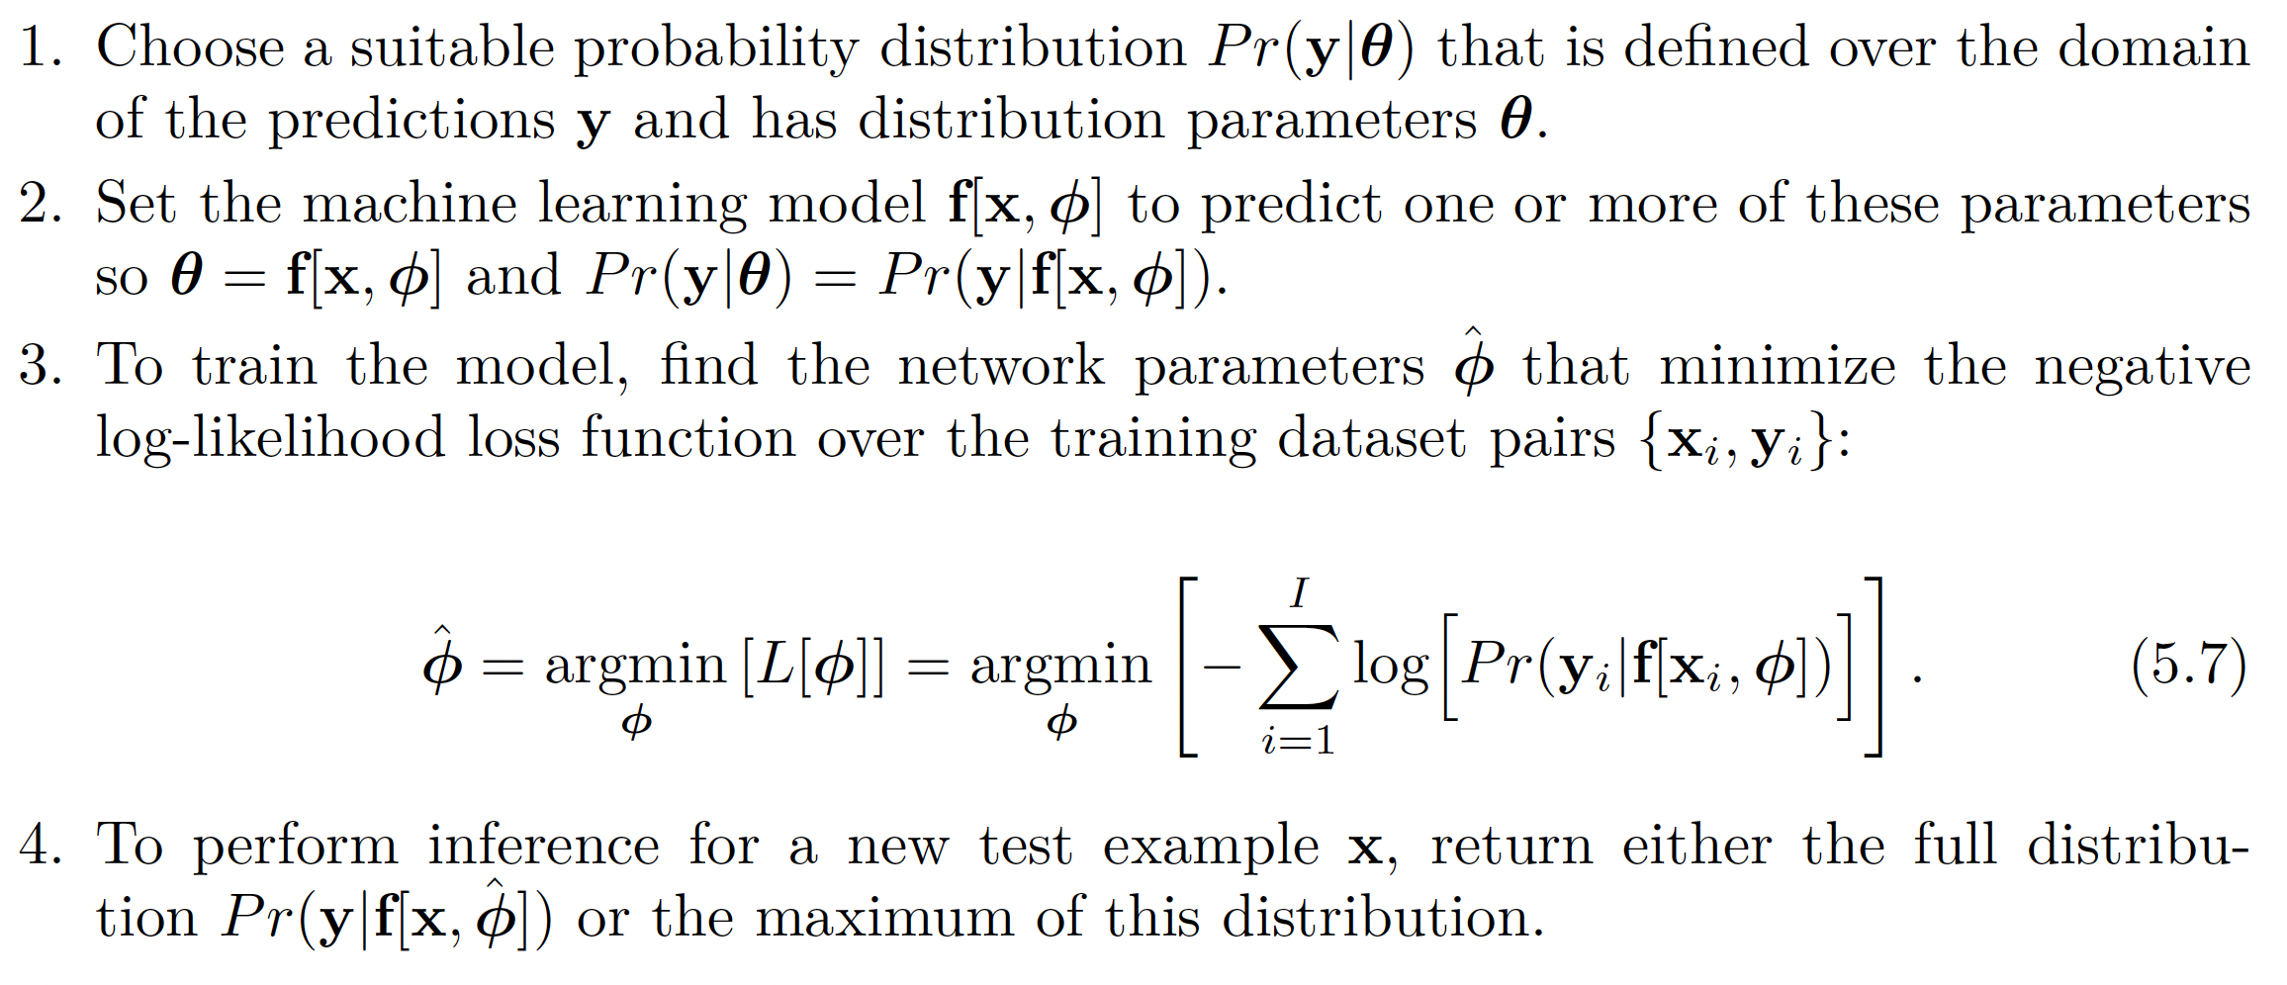
Recipe for loss functions

Slide 52
Loss functions
Maximum likelihood
Recipe for loss functions
Example 1: univariate regression
Example 2: binary classification
Example 3: multiclass classification
Other types of data
Multiple outputs
Cross entropy

Slide 53
Example 1: univariate regression

Slide 54
Example 1: univariate regression
Predict scalar output:
Sensible probability distribution:
Normal distribution

Slide 55
Example 1: univariate regression

Slide 56
Example 1: univariate regression

Slide 57
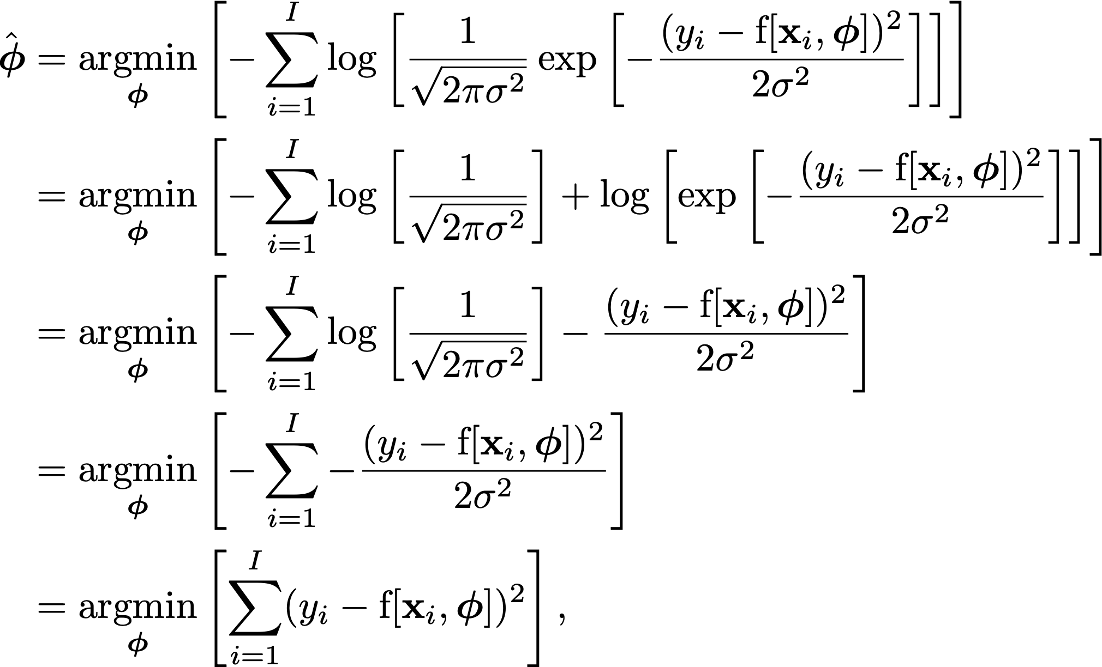

Slide 60
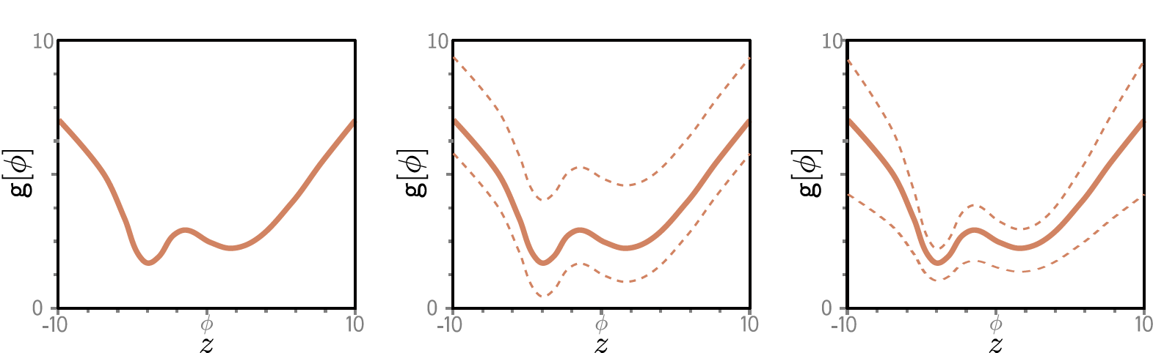

Slide 63
Least squares!

Slide 64
Least squares
Maximum likelihood

Slide 65
Least squares
Maximum likelihood

Slide 66
Example 1: univariate regression

Slide 67
Estimating variance
Perhaps surprisingly, the variance term disappeared:
But we could learn it:

Slide 68
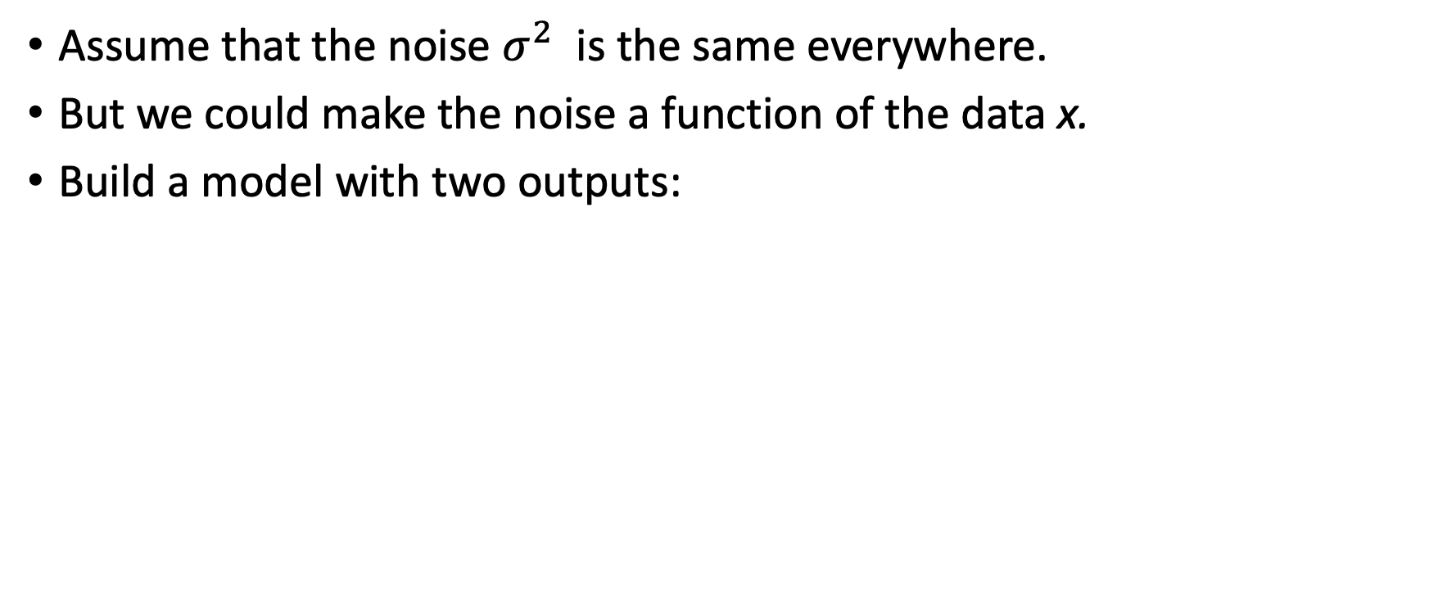
Heteroscedastic regression
Assume that the noise $σ^{2}$ is the same everywhere.
But we could make the noise a function of the data x.
Build a model with two outputs:

Slide 69
Heteroscedastic regression

Slide 70
Loss functions
Maximum likelihood
Recipe for loss functions
Example 1: univariate regression
Example 2: binary classification
Example 3: multiclass classification
Other types of data
Multiple outputs
Cross entropy

Slide 71
Example 2: binary classification
Goal: predict which of two classes the input x belongs to

Slide 72
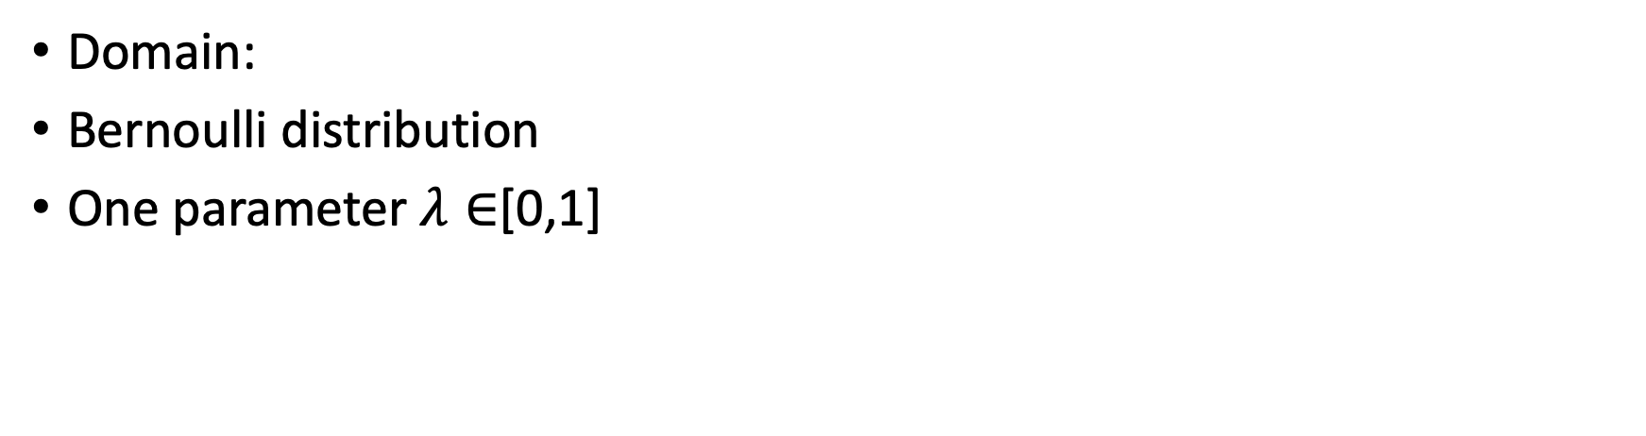
Example 2: binary classification
Domain:
Bernoulli distribution
One parameter $λ∈$[0,1]

Slide 73
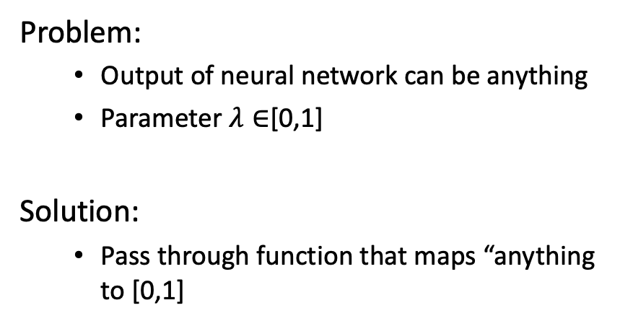
Example 2: binary classification
Problem:
Output of neural network can be anything
Parameter $λ∈$[0,1]
Solution:
Pass through function that maps “anything to [0,1]

Slide 74
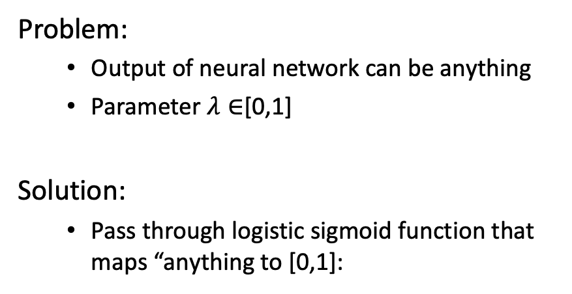
Example 2: binary classification
Problem:
Output of neural network can be anything
Parameter $λ∈$[0,1]
Solution:
Pass through logistic sigmoid function that maps “anything to [0,1]:

Slide 75
Example 2: binary classification

Slide 76
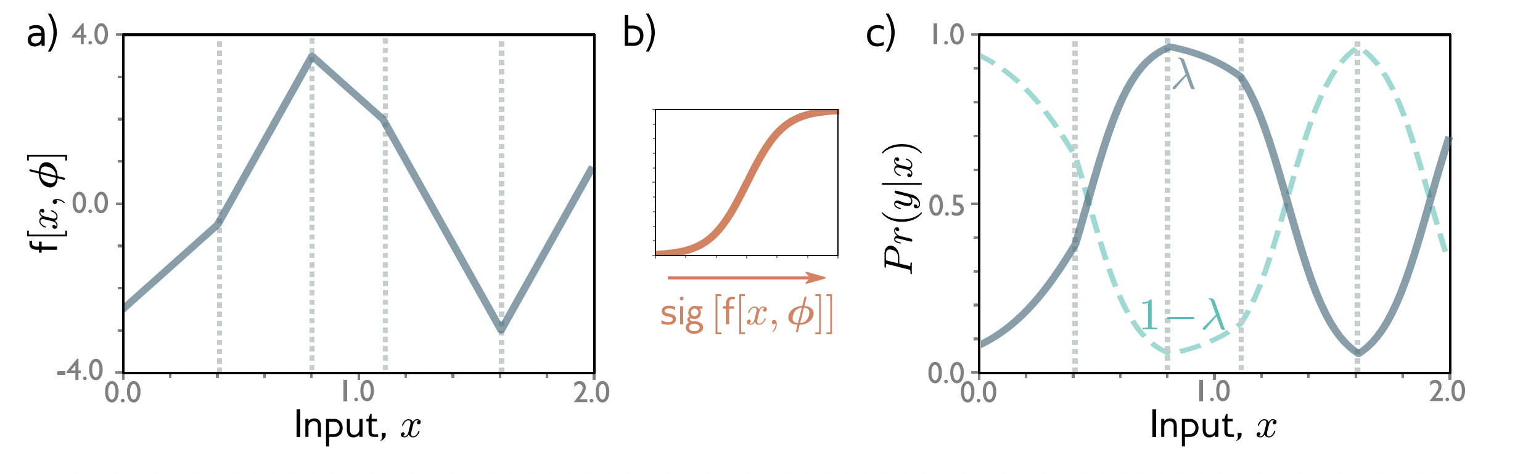
Example 2: binary classification

Slide 77
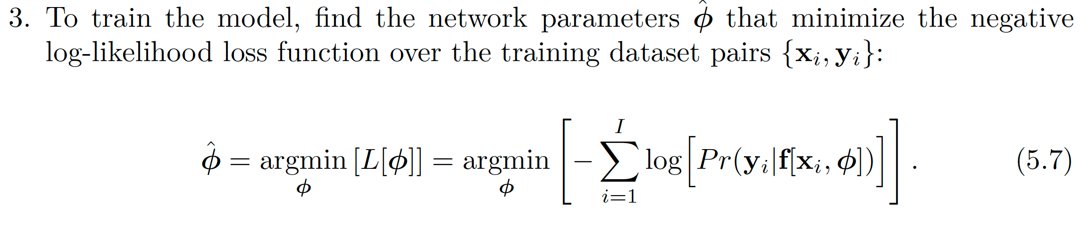
Example 2: binary classification
*Binary cross-entropy loss*

Slide 78
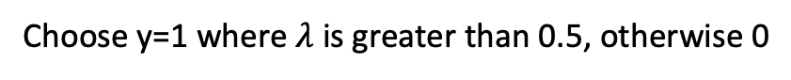
Example 2: binary classification
Choose y=1 where $λ$ is greater than 0.5, otherwise 0

Slide 79
Loss functions
Maximum likelihood
Recipe for loss functions
Example 1: univariate regression
Example 2: binary classification
Example 3: multiclass classification
Other types of data
Multiple outputs
Cross entropy

Slide 80
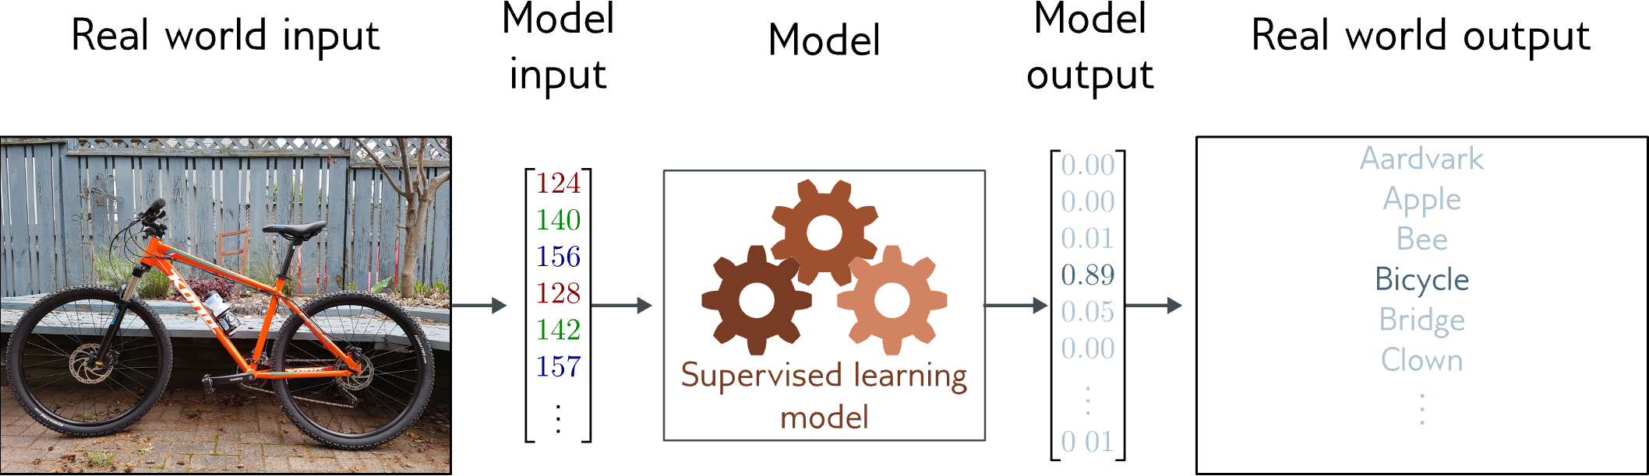
Example 3: multiclass classification
Goal: predict which of K classes the input x belongs to

Slide 81
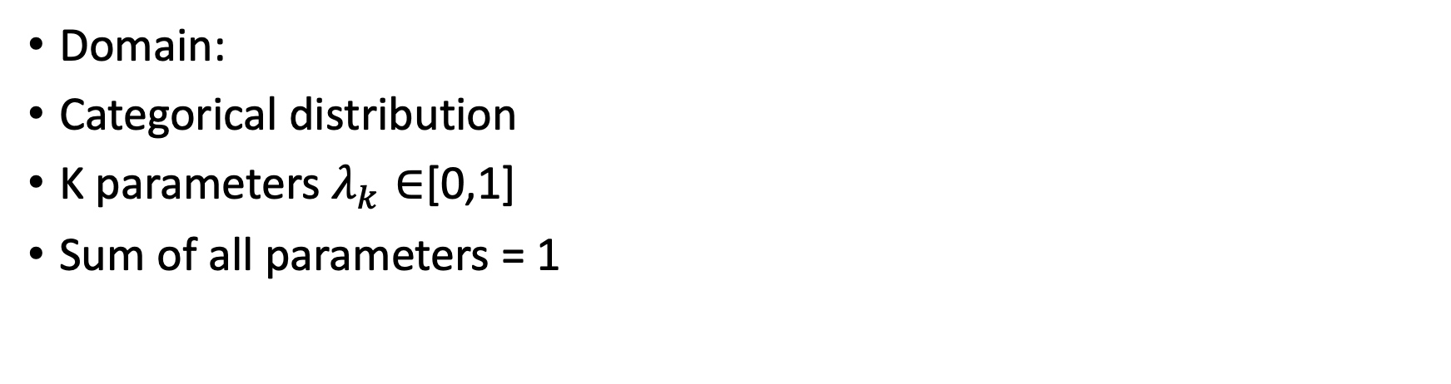
Example 3: multiclass classification
Domain:
Categorical distribution
K parameters $λ_{k}∈$[0,1]
Sum of all parameters = 1

Slide 82
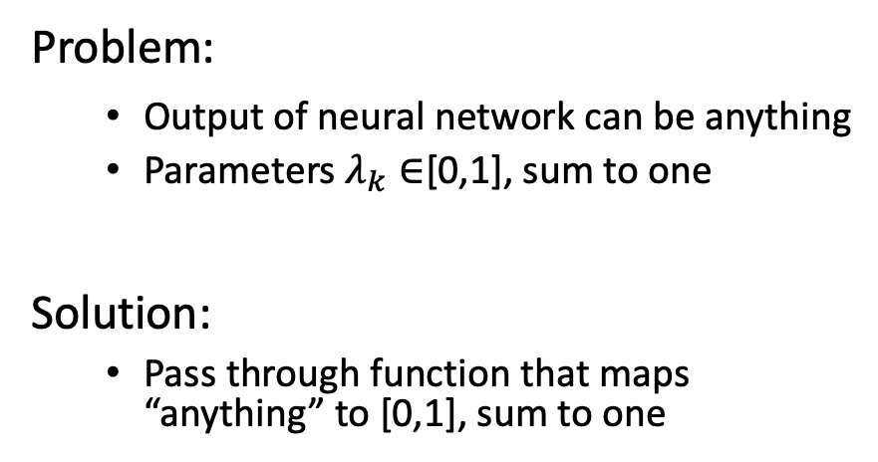
Example 3: multiclass classification
Problem:
Output of neural network can be anything
Parameters $λ_{k}∈$[0,1], sum to one
Solution:
Pass through function that maps “anything” to [0,1], sum to one

Slide 83
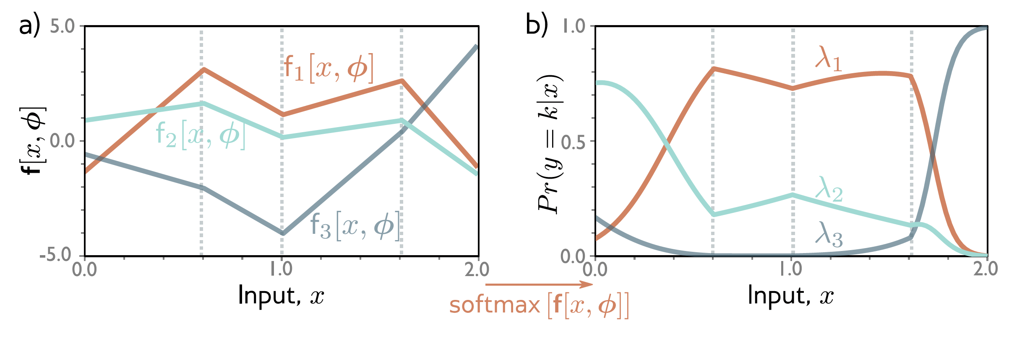
Example 3: multiclass classification

Slide 84
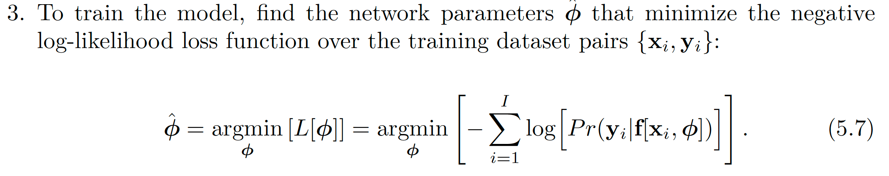
Example 3: multiclass classification
*Multiclass cross-entropy loss*

Slide 85
Example 3: multiclass classification
Choose the class with the largest probability

Slide 86
Loss functions
Maximum likelihood
Recipe for loss functions
Example 1: univariate regression
Example 2: binary classification
Example 3: multiclass classification
Other types of data
Multiple outputs
Cross entropy

Slide 87
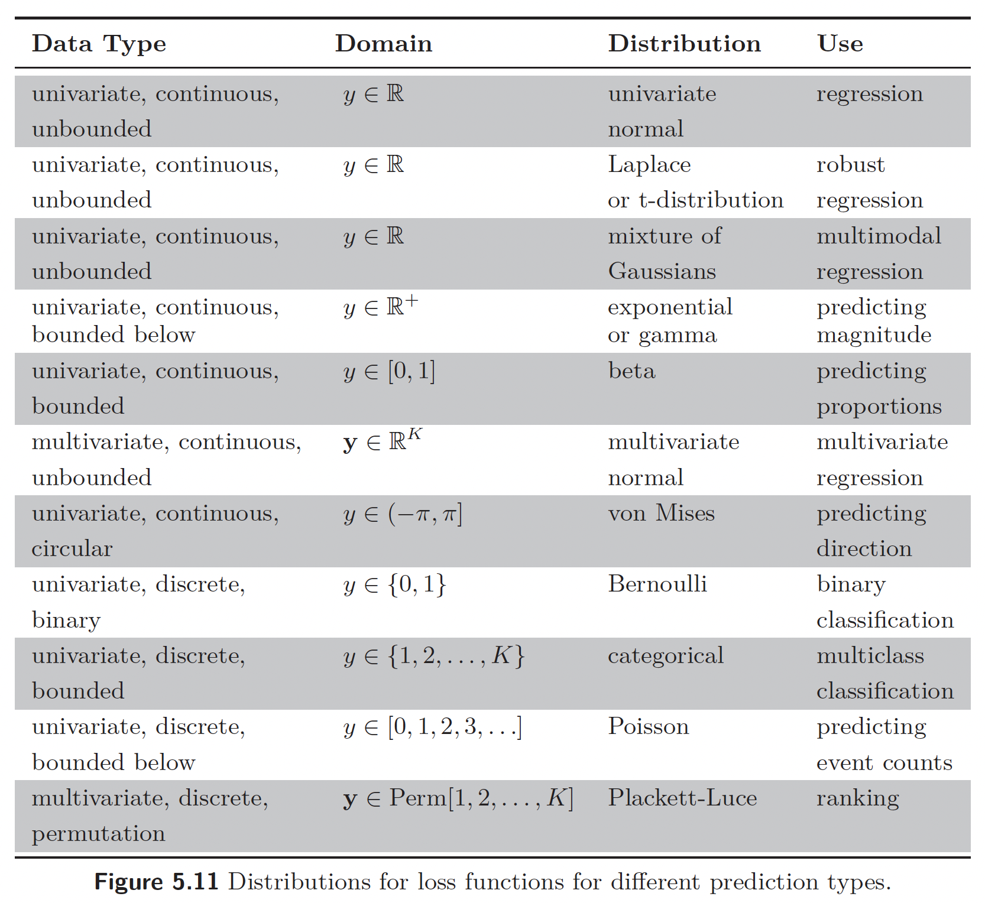
Other data types

Slide 88
Loss functions
Maximum likelihood
Recipe for loss functions
Example 1: univariate regression
Example 2: binary classification
Example 3: multiclass classification
Other types of data
Multiple outputs
Cross entropy

Slide 89
Multiple outputs
Treat each output as independent:
Negative log likelihood becomes sum of terms:

Slide 90
Example 4: multivariate regression

Slide 91
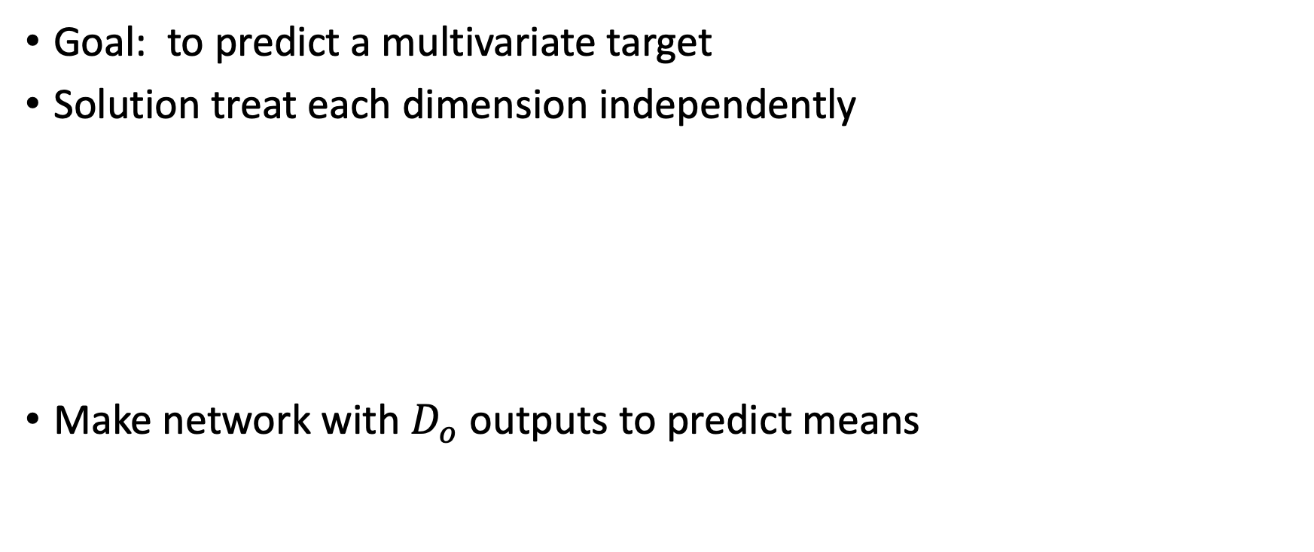
Example 4: multivariate regression
Goal: to predict a multivariate target
Solution treat each dimension independently
Make network with $D_{o}$ outputs to predict means

Slide 92
Example 4: multivariate regression
What if the outputs vary in magnitude
E.g., predict weight in kilos and height in meters
One dimension has much bigger numbers than others
Could learn a separate variance for each…
…or rescale before training, and then rescale output in opposite way

Slide 93
Loss functions
Maximum likelihood
Recipe for loss functions
Example 1: univariate regression
Example 2: binary classification
Example 3: multiclass classification
Other types of data
Multiple outputs
Cross entropy

Slide 94
Cross Entropy
Kullback-Leibler Divergence -- a measure between probability distributions

Slide 95
Cross Entropy
Kullback-Leibler Divergence -- a measure between probability distributions

Slide 96
Cross Entropy

Slide 97
Cross Entropy
Minimum negative log likelihood

Slide 98
Cross entropy in machine learning
Minimum negative log likelihood
In machine learning:

Slide 99
Next up
We have models with parameters!
We have loss functions!
Now let’s find the parameters that give the smallest loss
Training, learning, or fitting the model

Slide 100

Feedback

